Slide 1
Introduction to UML (Unified Modeling Language)
Understanding UML Diagrams and Their Applications

Slide 2
What is UML?
UML stands for Unified Modeling Language.
It is a standardized modeling language used in software engineering.
Helps in visualizing system architecture and design before implementation.

Slide 3
Why Use UML?
Provides a clear representation of system components.
Facilitates communication between stakeholders.
Helps in documentation and system design.
Supports various development methodologies (e.g., Agile, Waterfall).

Slide 4
Types of UML Diagrams
Structural Diagrams
Class Diagram
Object Diagram
Component Diagram
Deployment Diagram
Behavioral Diagrams
Use Case Diagram
Sequence Diagram
Activity Diagram
State Diagram
Communication Diagram

Slide 5
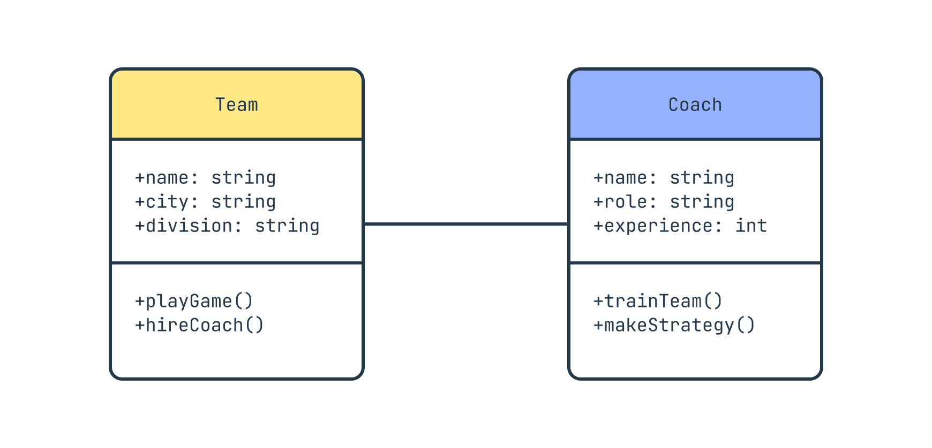
Class Diagram
Represents the static structure of a system.
Shows classes, attributes, methods, and relationships.

Slide 6
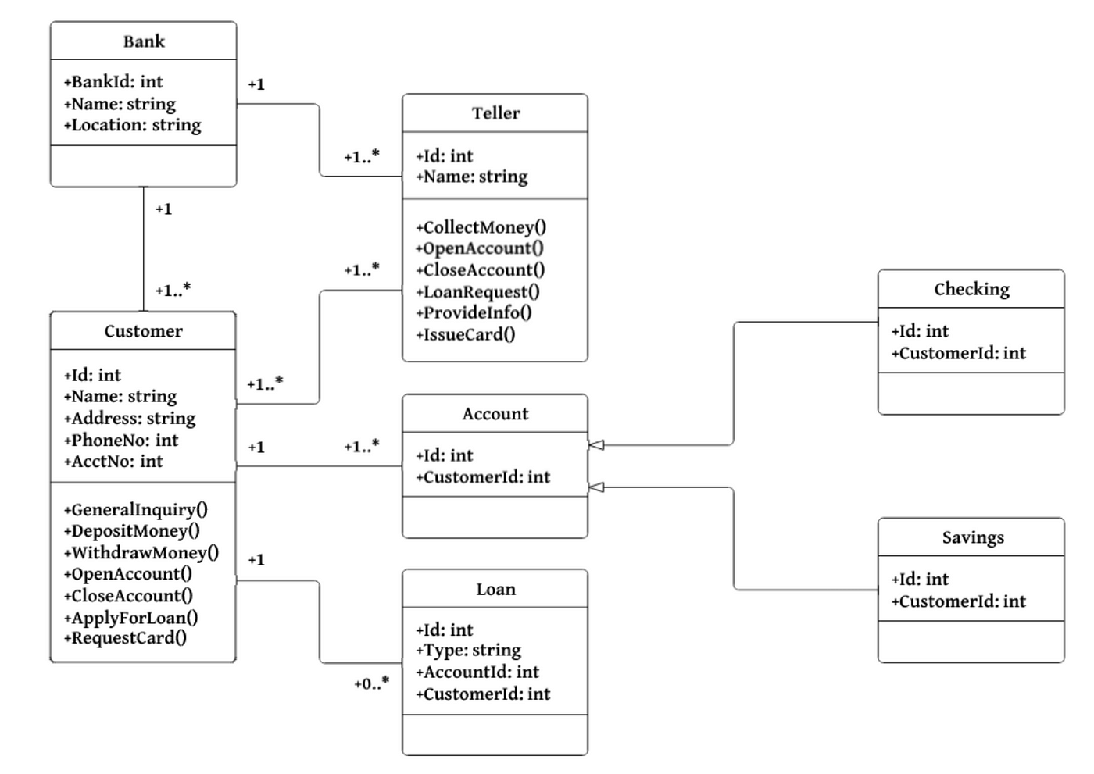

Slide 8
Use Case Diagram
Represents the interaction between users and the system.
Includes actors (users) and use cases (system functions).
Example:
User -> [Login]
User -> [Register]

Slide 9
Use Case Diagram example(Online Shopping System)
Actors:
Customer
Admin
Use Cases:
Browse Products
Add to Cart
Checkout
Manage Inventory (Admin)
Relations:
The Customer can browse products, add to the cart, and complete the checkout.
The Admin can manage the inventory.

Slide 10
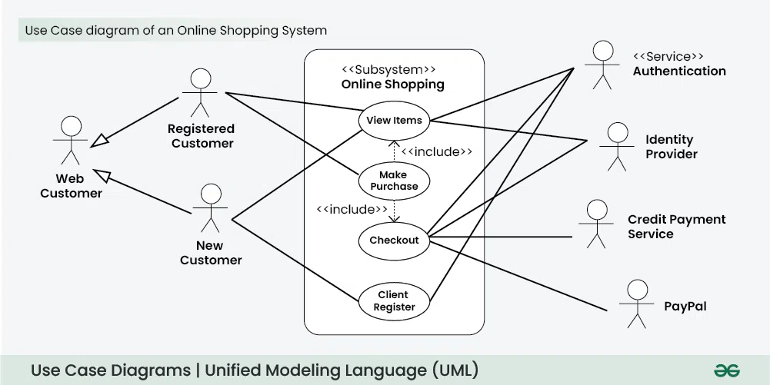

Slide 11
system flow
A system flow in IT refers to the logical sequence of processes, inputs, and outputs within a system. It describes how data moves through a system, how different components interact, and how operations are carried out to achieve a specific goal.

Slide 12
Types of System Flow
Data Flow – Shows how data is processed, stored, and transferred within the system.
Process Flow – Represents the sequence of steps or operations performed in a system.
Control Flow – Describes the decision-making process and execution order in a system.
User Flow – Focuses on how users interact with a system (e.g., logging in, performing actions, receiving feedback).

Slide 13
Data Flow (DFD Example)
User → [Enter Booking Details] → System
System → [Verify Availability] → Database
Database → [Send Confirmation] → System
System → [Display Confirmation] → User
Explanation: This shows how data (booking details) flows between the user, system, and database.

Slide 14
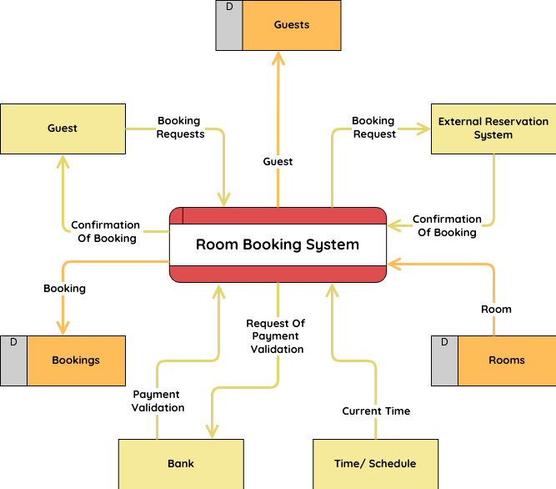

Slide 15
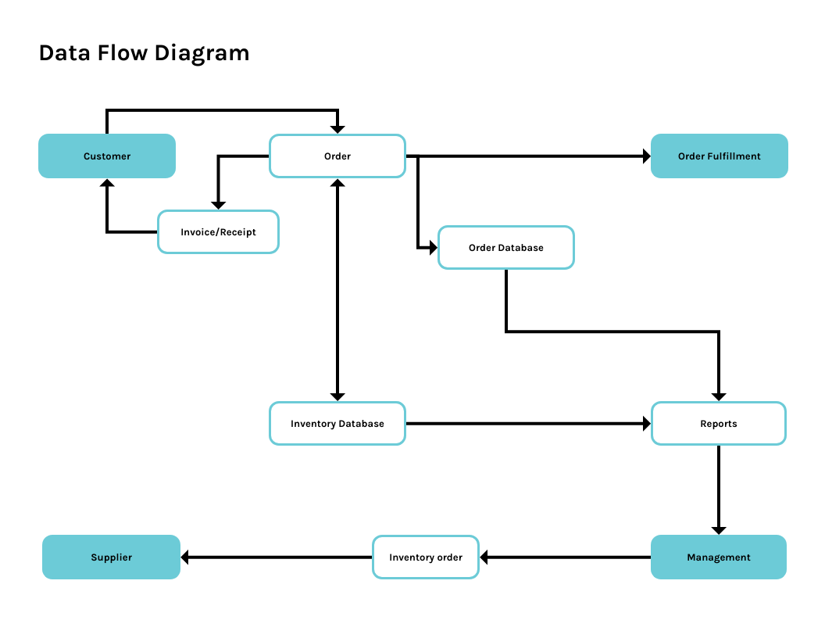

Slide 16
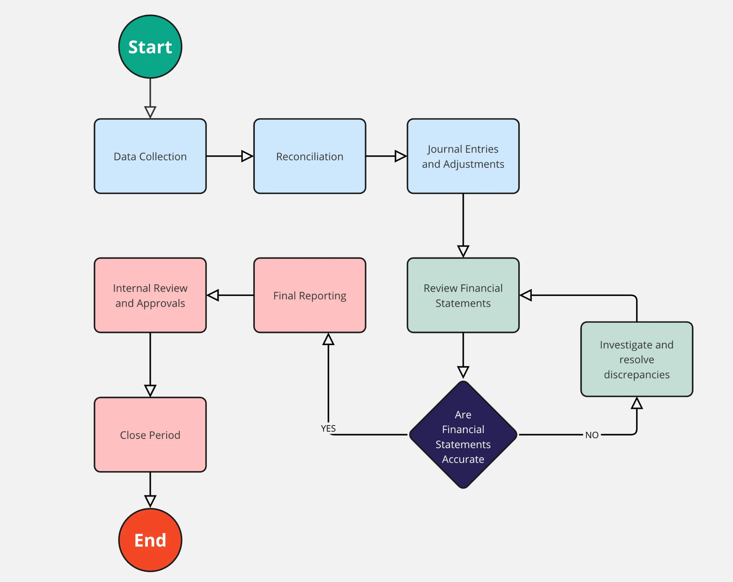
Process Flow

Slide 17
Control Flow (Decision-based)
Start → User Submits Loan Application
→ Check Credit Score
→ If Score > 700 → Approve Loan → End
→ If Score < 700 → Reject Loan → End
💡 Explanation: This shows how decisions affect the flow of the system.

Slide 18
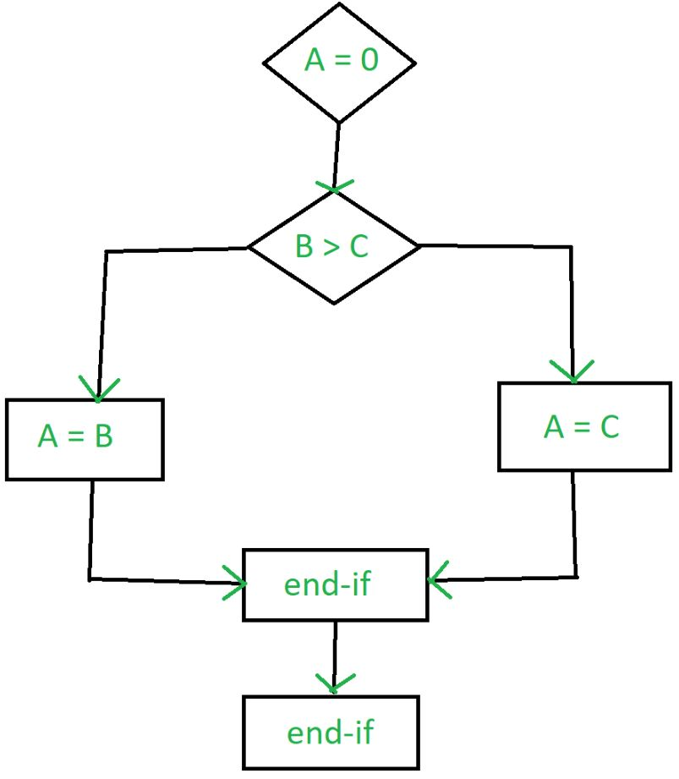

Slide 19
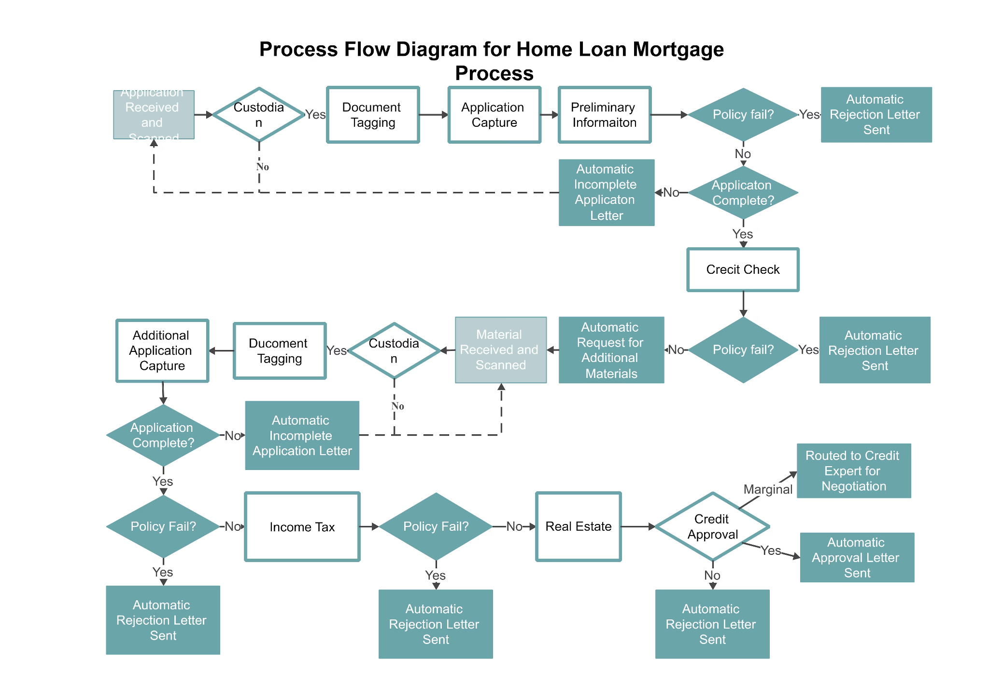

Slide 20
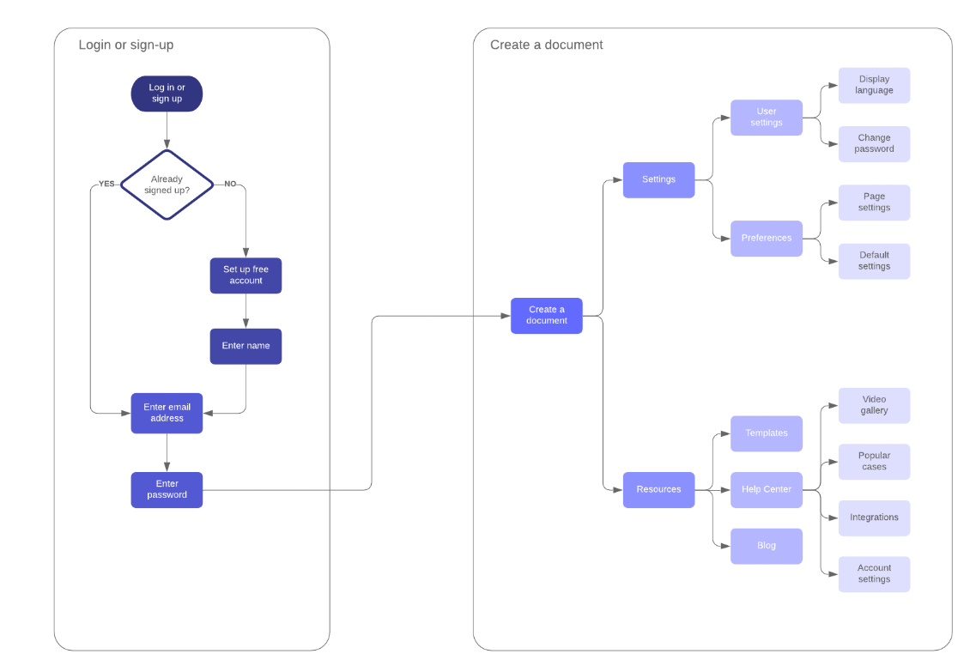
User
Flow
(Interaction-based)

Slide 21
Sequence Diagram
https://www.geeksforgeeks.org/unified-modeling-language-uml-class-diagrams/
https://www.geeksforgeeks.org/use-case-diagram/

